Slide 1
Fresh Grads – Group Project
Doctor Appointment Application

Slide 2
Problem Statement
To Create an Application for online appointment with Doctor
Customer can Login/Signup to application.
Customer should be able to take appointment with Doctor
Customer should be able view appointment status
Customer can give the feedback about Doctor .
Admin should be able to approve or reject the appointment.
Admin can add/modify/view/remove patient
Admin can add/modify/view/remove Doctor
Admin can view list patient
Doctor can login and view the list of appointment, list of patients,
Doctor can cancel appointment

Slide 3
Road Map
Application will be developed in following Sprints –
Core Java +JPA with Hibernate
Spring Boot + Rest Controller + JPA with Hibernate
Angular for UI design (Front End) + Integration with previous Sprint

Slide 4
Plan
Design
Generate the skeleton as per class design provided
TDD approach
Identify test cases for each module
Write Failing Test cases
Convert the Test Cases in GREEN
Implement the case study in incremental manner

Slide 5
Modules
Login Module
Appointment Module
Doctor module
Admin Module
Feedback Module
Patient Module

Slide 6
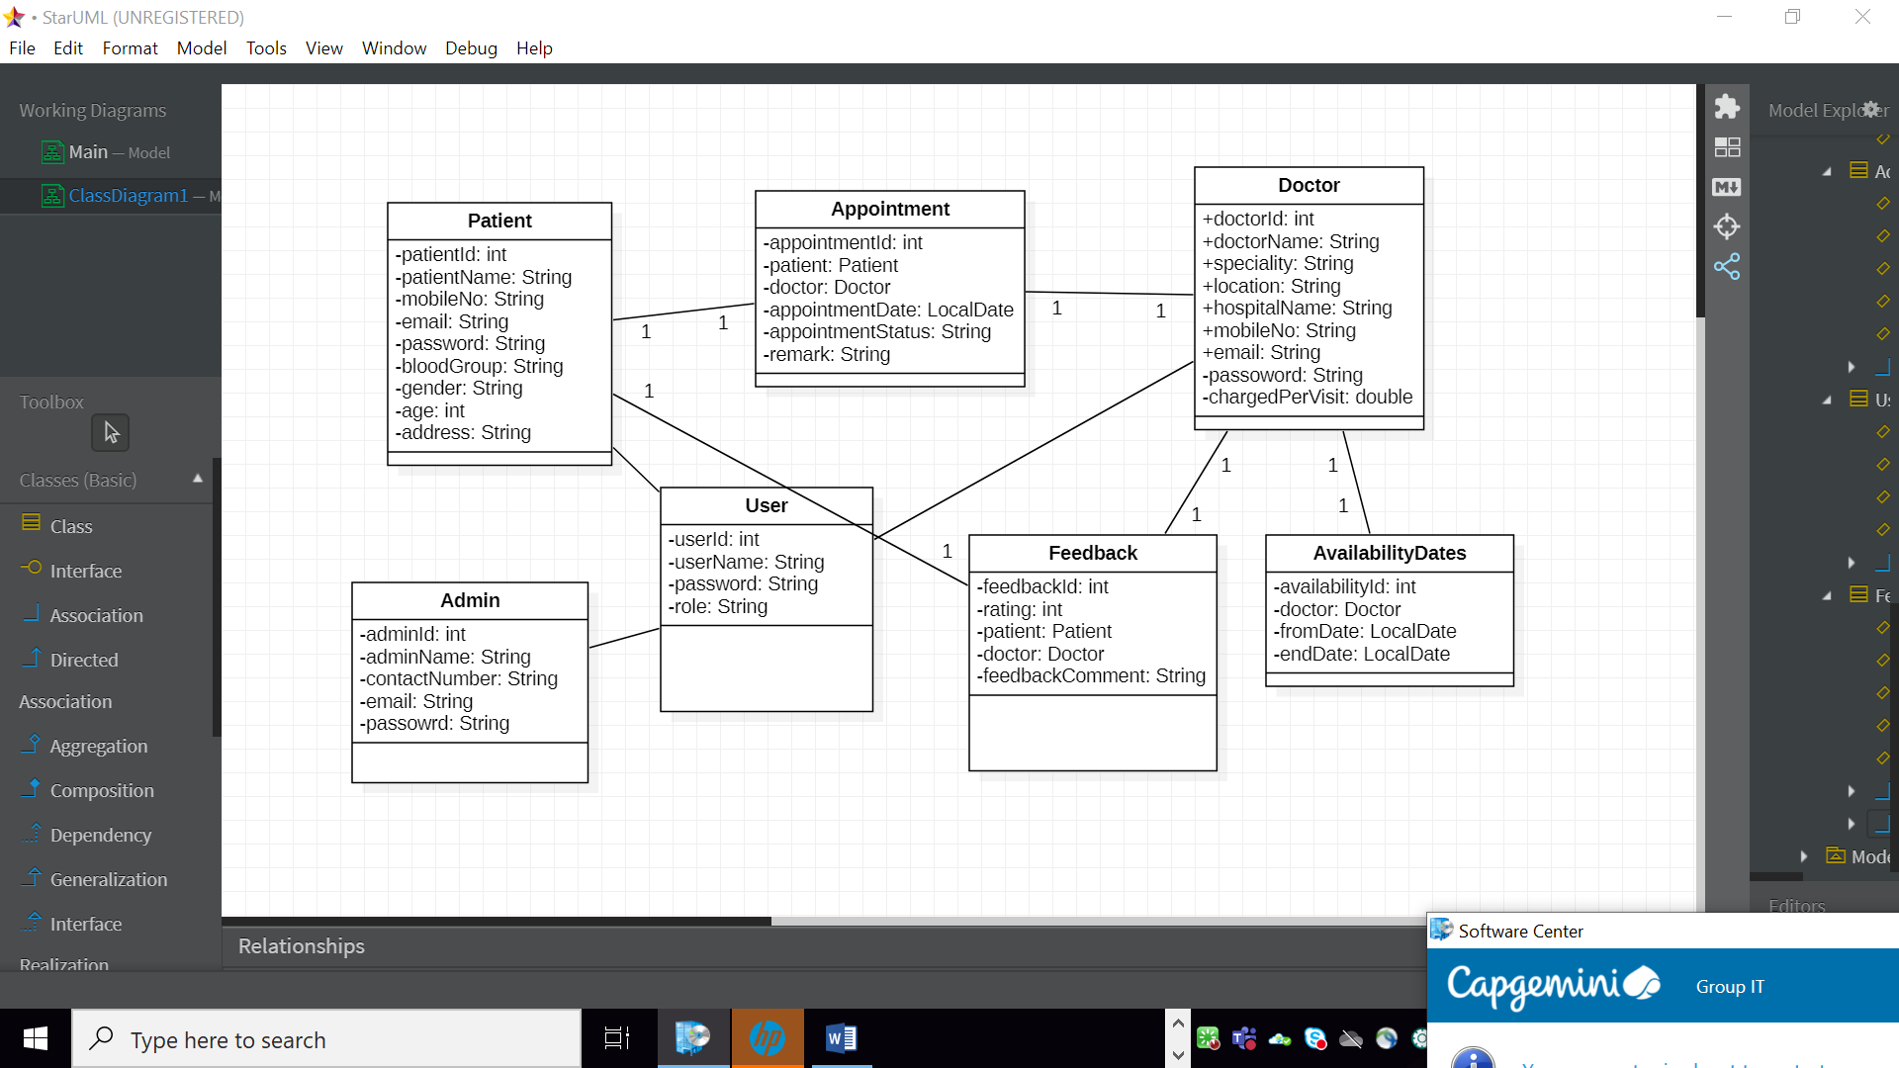
Class Design
POJO Classes:

Slide 7
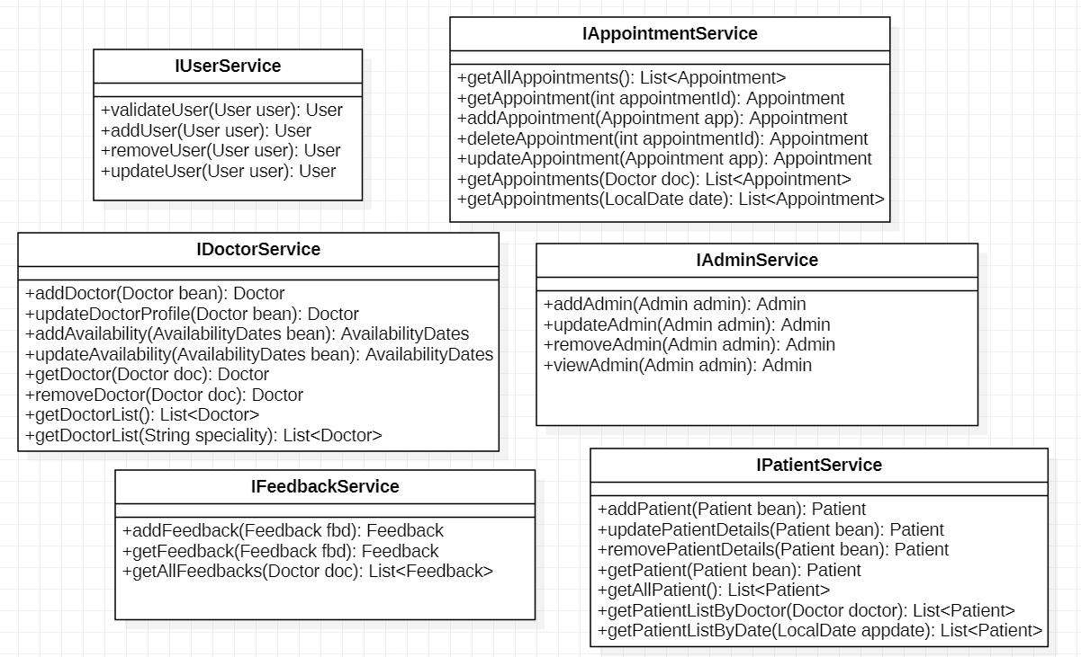
Class Design
Service Interface:

Slide 8
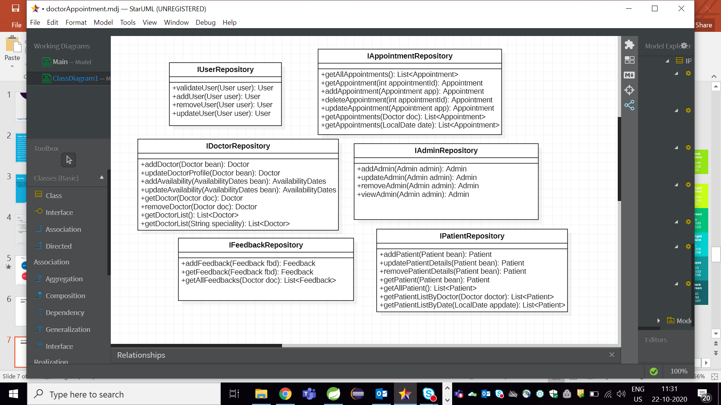
Class Design
Repository:

Slide 9




Questions

